Slide 1


www.hologen-network.org
Advancing the development and implementation of hologenomics in biological sciences
Funded by the European Union under Grant Agreement 101169005

Slide 2



www.hologen-network.eu
Research
ethics
Ostaizka Aizpurua
ostaizka.aizpurua@sund.ku.dk

Slide 3
www.hologen-network.eu
20th-century
Tuskegee Syphilis Study (1932–1972), where African men with syphilis were misled and denied treatment so researchers could observe the disease's progression.
Nazi Medical Experiments (WWII, 1939–1945)
The atrocities included non-consensual experiments on concentration camp prisoners, many of which were deadly or caused severe suffering.
Stanford Prison Experiment (1971)
24 healthy male college students were assigned to play either guards or prisoners in a mock prison in the university basement.
The study was supposed to last 2 weeks, but it was terminated after only 6 days because of extreme psychological distress.
Henrietta Lacks and the HeLa Cells (1951 onwards)
Henrietta Lacks, a poor African American woman, was treated for cervical cancer at Johns Hopkins Hospital.
Without her knowledge or consent, doctors collected cancerous cells from her tumor.
These cells became the first immortal human cell line ("HeLa cells"), which are still used worldwide in scientific research (e.g., polio vaccine, cancer, virology).
Her family only found out decades later that her cells were commercialized and widely distributed.

Slide 4

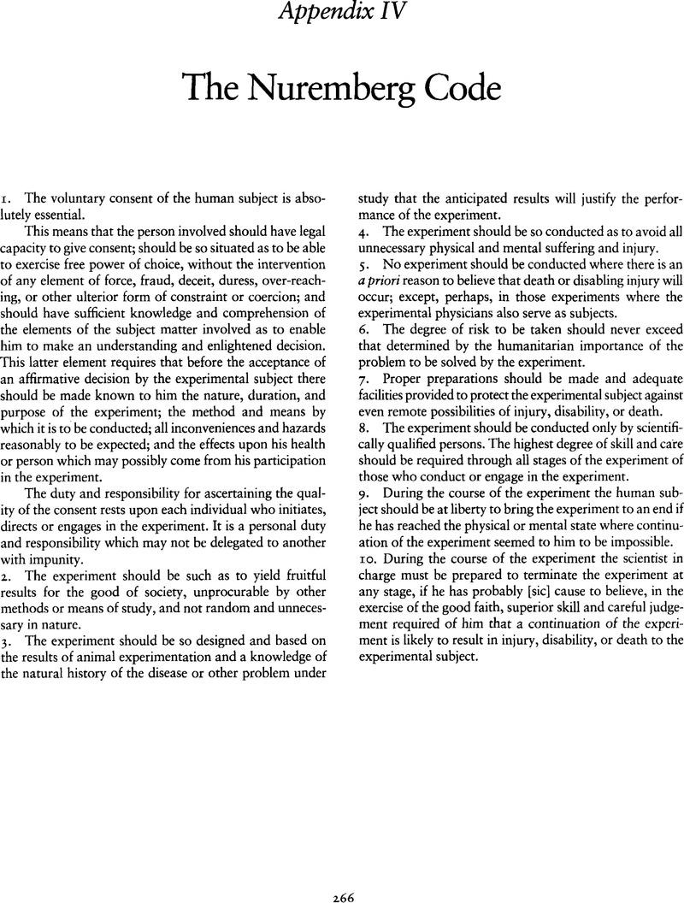
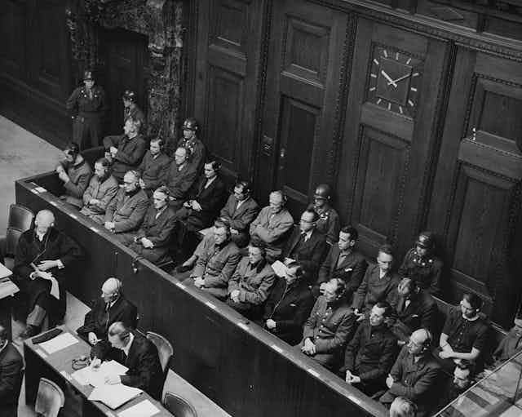
www.hologen-network.eu
Nuremberg Code (1947)
The first formal set of principles for ethical human experimentation
Universal ethical standard for all human research, following the Nuremberg Trials after World War II
It state: The voluntary consent of the human subject is absolutely essential
First advocated voluntary participation and informed consent. Not binding

Slide 5
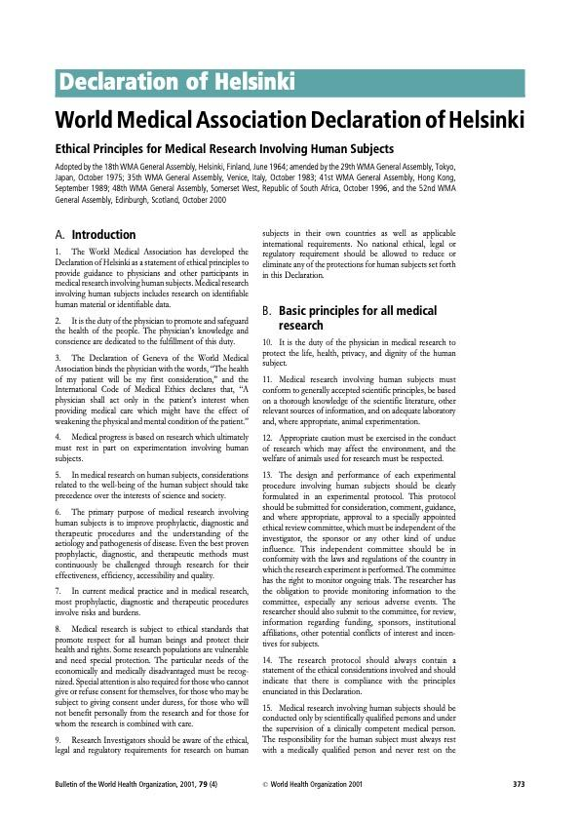
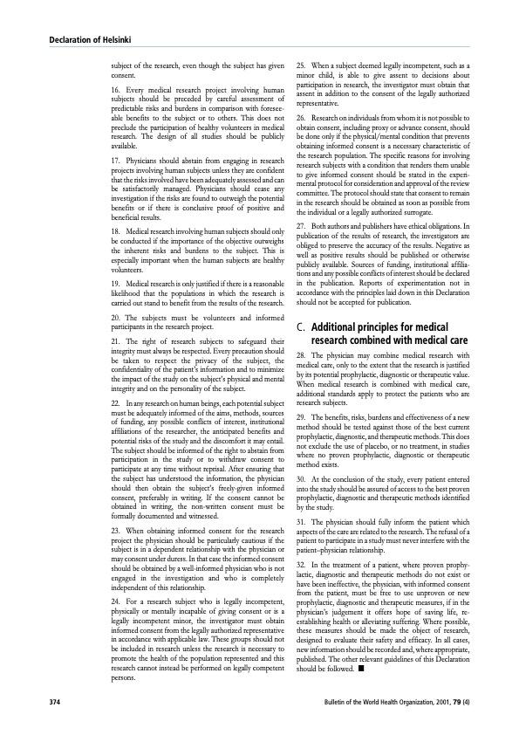
www.hologen-network.eu
Declaration of Helsinki (1964, updated)
Adopted by the World Medical Association as a guide for physicians involved in human research
Widely recognized but not legally binding

Slide 6
www.hologen-network.eu
Oviedo convention (Convention on Human Rights and Biomedicine), 1998
The only international legally binding instrument on the protection of human rights in the biomedical field
Core Principles:
Respect for human dignity and rights in biomedical activities
Informed consent and protection of vulnerable individuals
Ban on financial gain from the human body and its parts
Ethical governance of biomedical research
EU Directive 2010/63/EU
Protection of animals used for scientific purposes
EU regulation 536/2014
Clinical trials regulation
https://www.coe.int/en/web/conventions/full-List?module=signatures-by-treaty&treatynum=164&utm_source=chatgpt.com
Notes:
European Code of Conduct for Research Integrity (ALLEA code): https://allea.org/code-of-conduct/

Slide 7
www.hologen-network.eu
21st century
CRISPR Babies (China, 2018)
CRISPR gene-editing technology to alter the DNA of twin embryos to make them resistant to HIV
Without proper oversight, transparency, or community consent.
The first known gene-edited humans.
https://pmc.ncbi.nlm.nih.gov/articles/PMC6724388/
COVID-19 Challenge Trials (2020–2021)
Scientists deliberately infected healthy volunteers with COVID-19 in "human challenge trials" to speed up vaccine research
Volunteers were compensated but exposed to real risk without guaranteed treatments.
https://pmc.ncbi.nlm.nih.gov/articles/PMC9124157/
https://www.science.org/content/article/controversial-human-challenge-trials-covid-19-vaccines-gain-support
AI Bias in Health Research (Ongoing, 2020s)
Studies show that AI models in healthcare (e.g., diagnostic tools, predictive algorithms) often inherit biases
Example: an AI model used to prioritise patients for care was found to systematically underestimate the health needs of some ethnic groups

Slide 8
www.hologen-network.eu
Groups discussion
What are the ethical consideration required to conduct a research study?
1 min think on your own
15 min group discussion

Slide 9



www.hologen-network.eu
Human studies

Slide 10
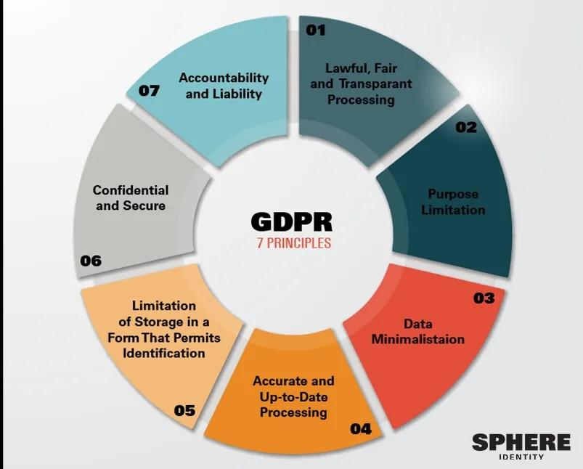

www.hologen-network.eu
Human studies
Ethics Approval
Research Ethics Committee
GDPR compliance
Personal data
https://gdpr.eu/tag/gdpr/
Notes:
If your study involves personal data of EU citizens or residents, you must comply with GDPR even if you’re not in the EU.
Lawfulness, fairness and transparency — Processing must be lawful, fair, and transparent to the data subject.
Purpose limitation — You must process data for the legitimate purposes specified explicitly to the data subject when you collected it.
Data minimization — You should collect and process only as much data as absolutely necessary for the purposes specified.
Accuracy — You must keep personal data accurate and up to date.
Storage limitation — You may only store personally identifying data for as long as necessary for the specified purpose.
Integrity and confidentiality — Processing must be done in such a way as to ensure appropriate security, integrity, and confidentiality (e.g. by using encryption).
Accountability — The data controller is responsible for being able to demonstrate GDPR compliance with all of these principles.

Slide 11
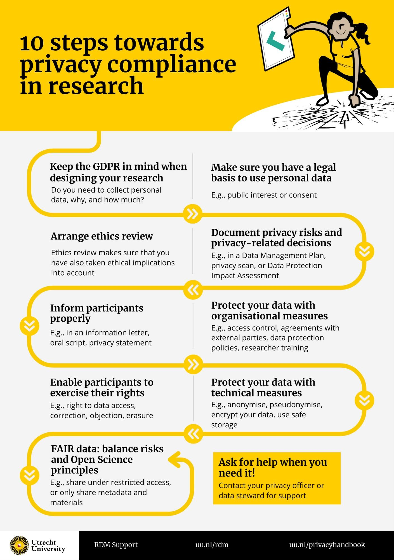
www.hologen-network.eu
May need to submit:
Data Protection Impact Assessment
Data Protection Officer
Data Management Plan

Slide 12
www.hologen-network.eu
Human studies
Ethics Approval
GDPR compliance
Clinical Trials Regulation (EU 536/2014)
Vulnerable populations
Extra institutional permissions
Cross-border studies -> approval in each country
Final Reports & Changes in protocols

Slide 13
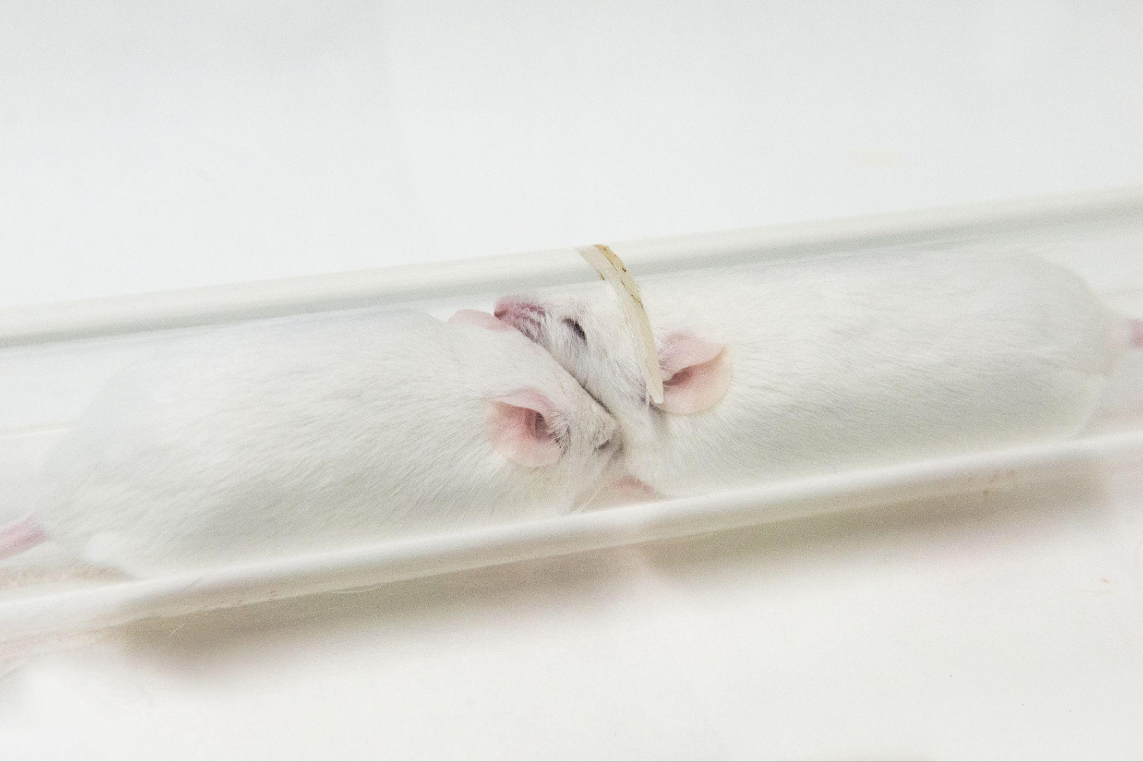
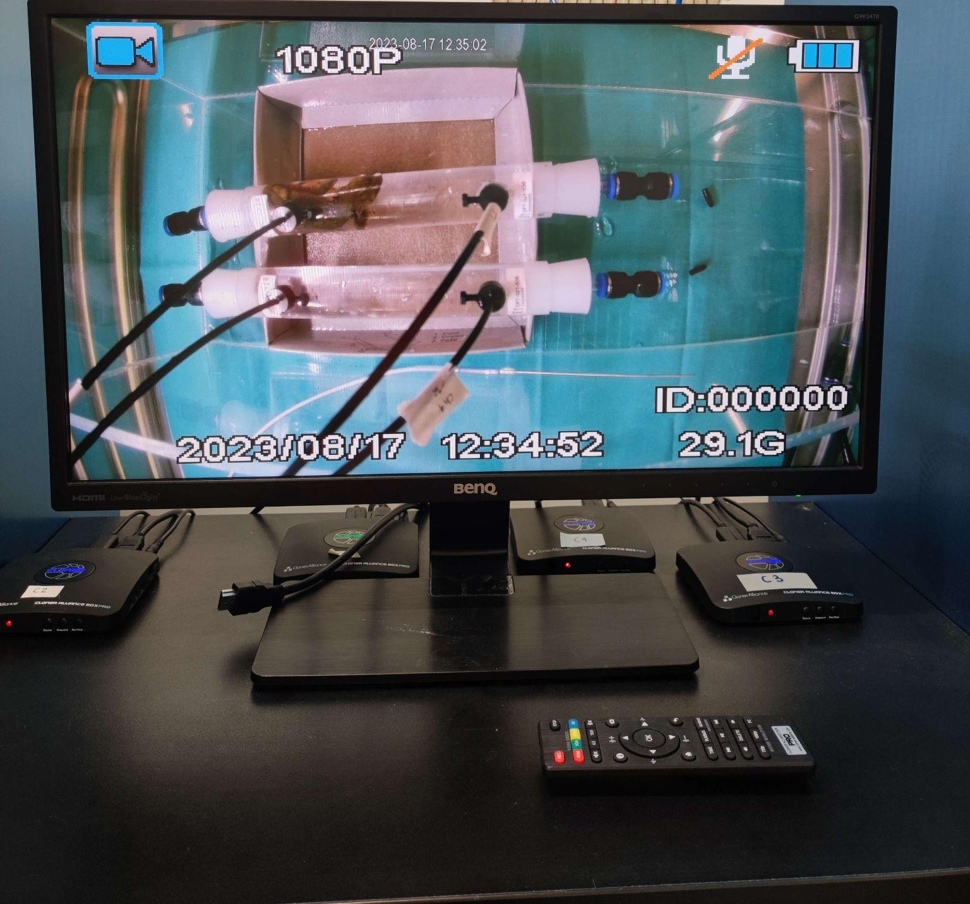

www.hologen-network.eu
Animal studies

Slide 14
www.hologen-network.eu
Animal research ethics
EU Directive 2010/63/EU
Ethical Review
The Principles of Humane Experimental Technique
3Rs
William Russell & Rex Burch, 1959
Free book: https://replacinganimalresearch.org.uk/the-3rs-and-the-humanity-criterion/

Slide 15

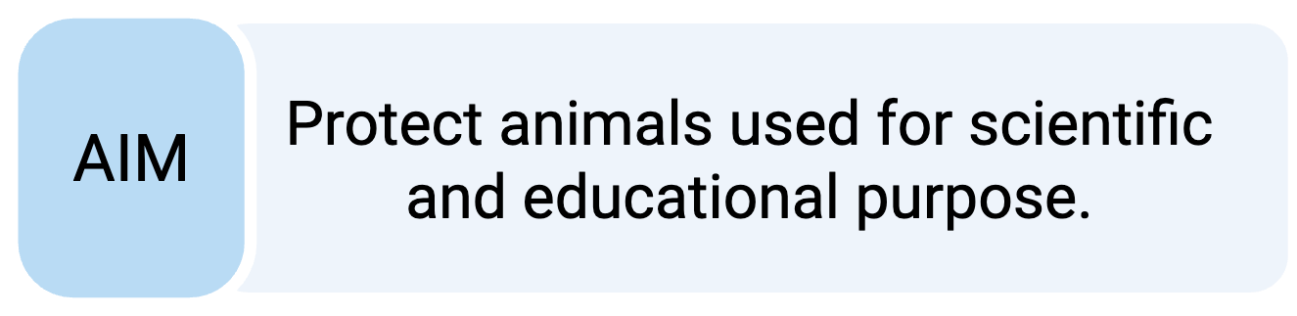

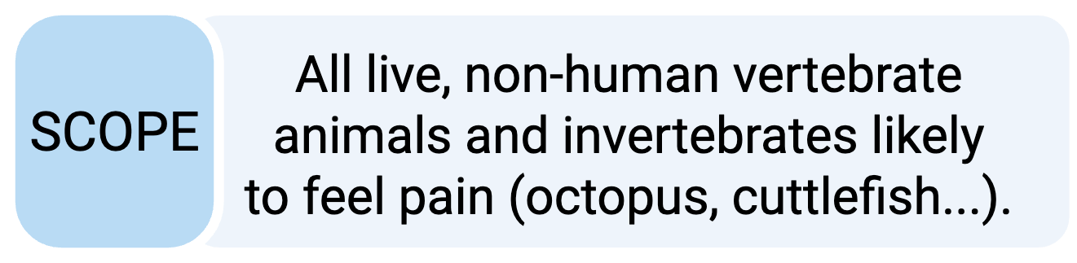






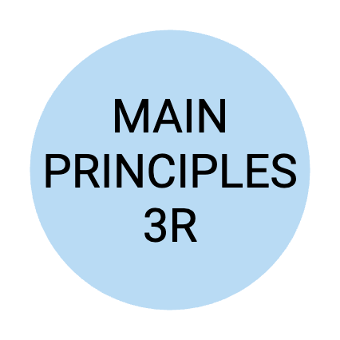





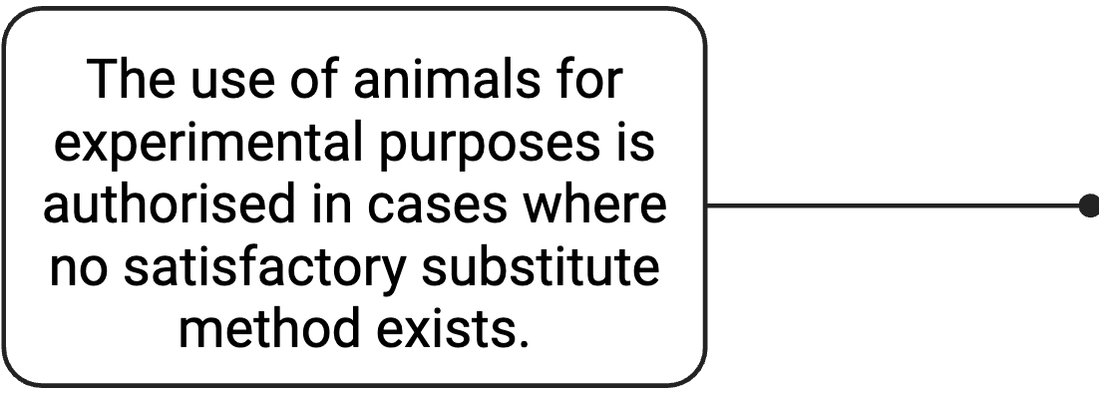
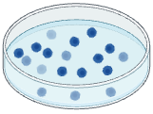

www.hologen-network.eu
3Rs principles
REDUCE
REFINE
REPLACE
biorender

Slide 16
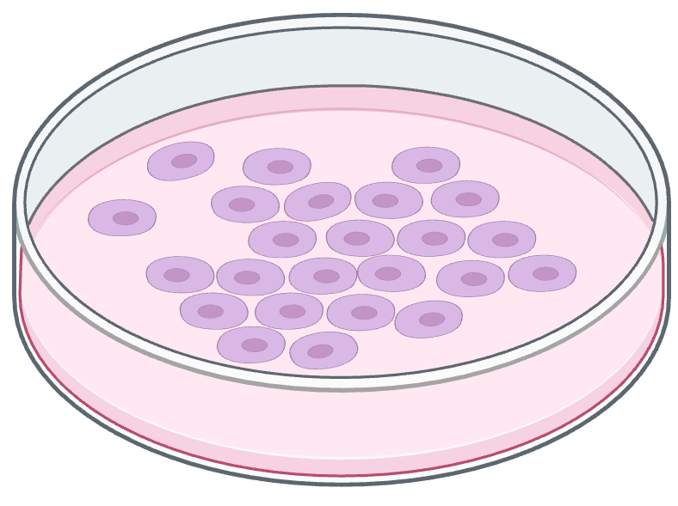
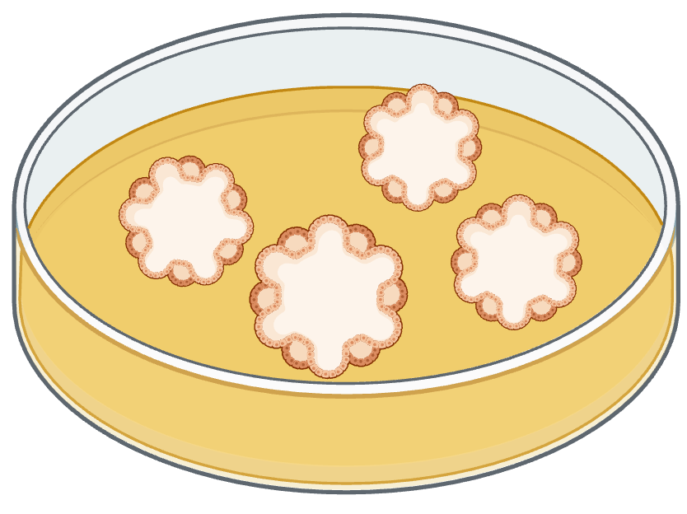
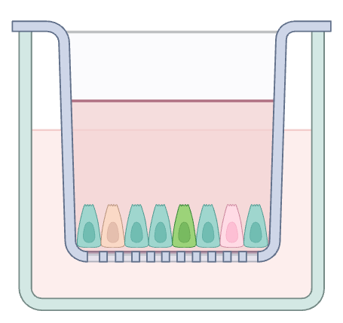
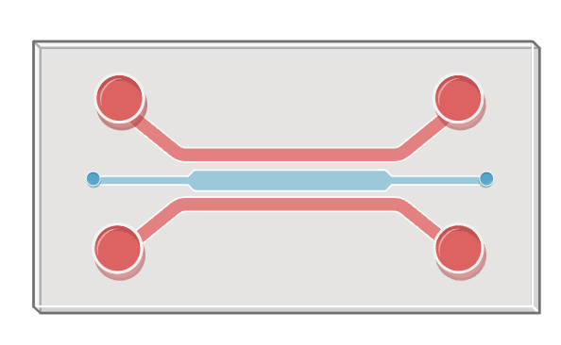
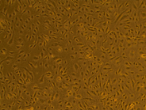
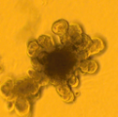
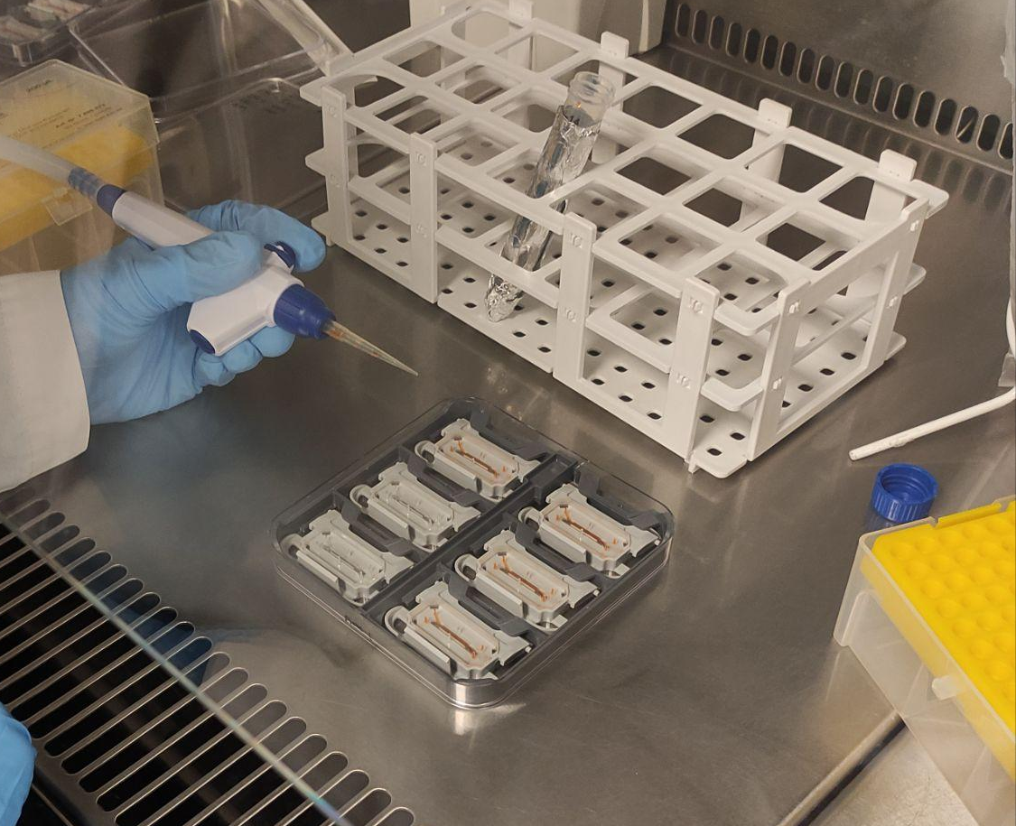
www.hologen-network.eu
Replace
Cell lines
Organoids
Transwell - Microfluidics

Slide 17
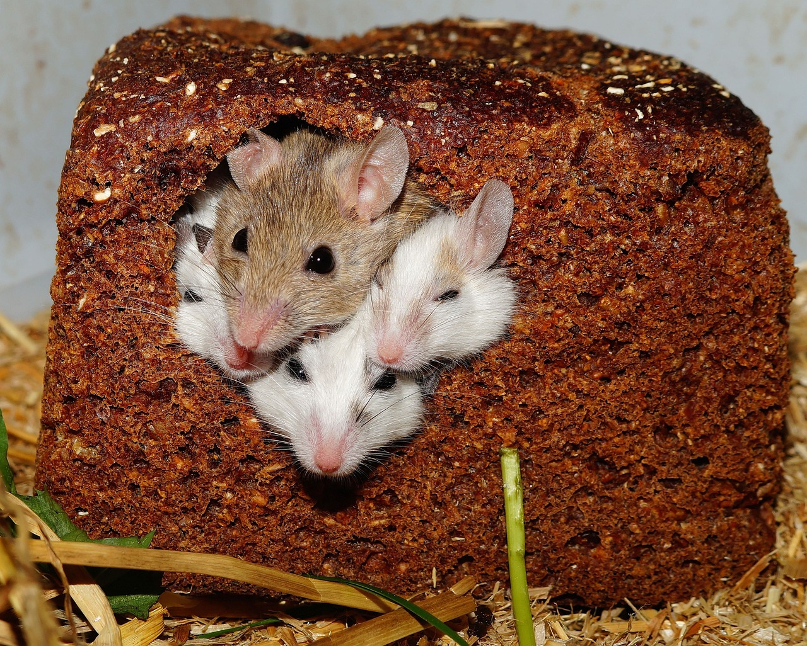
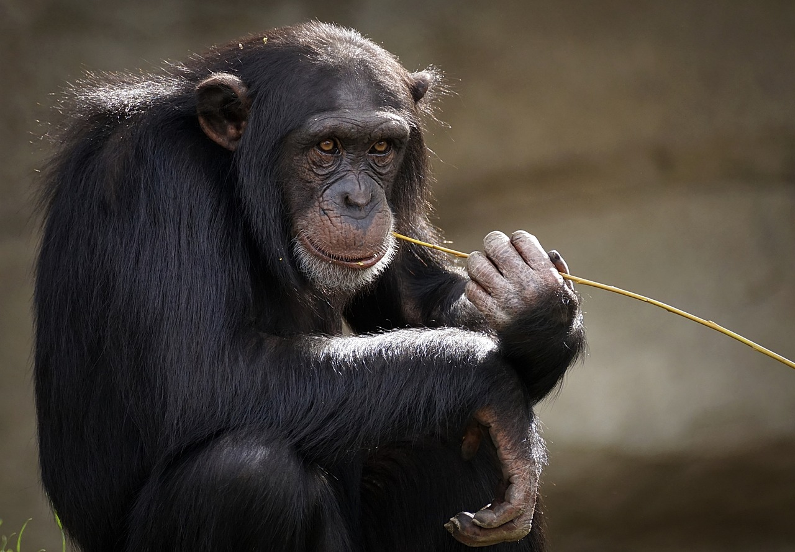
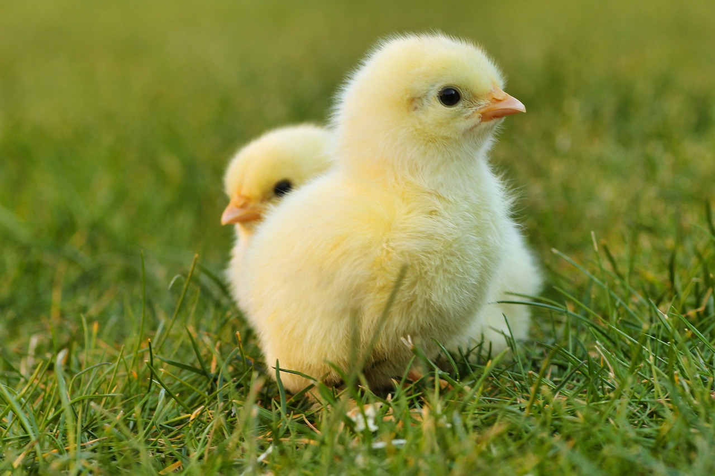
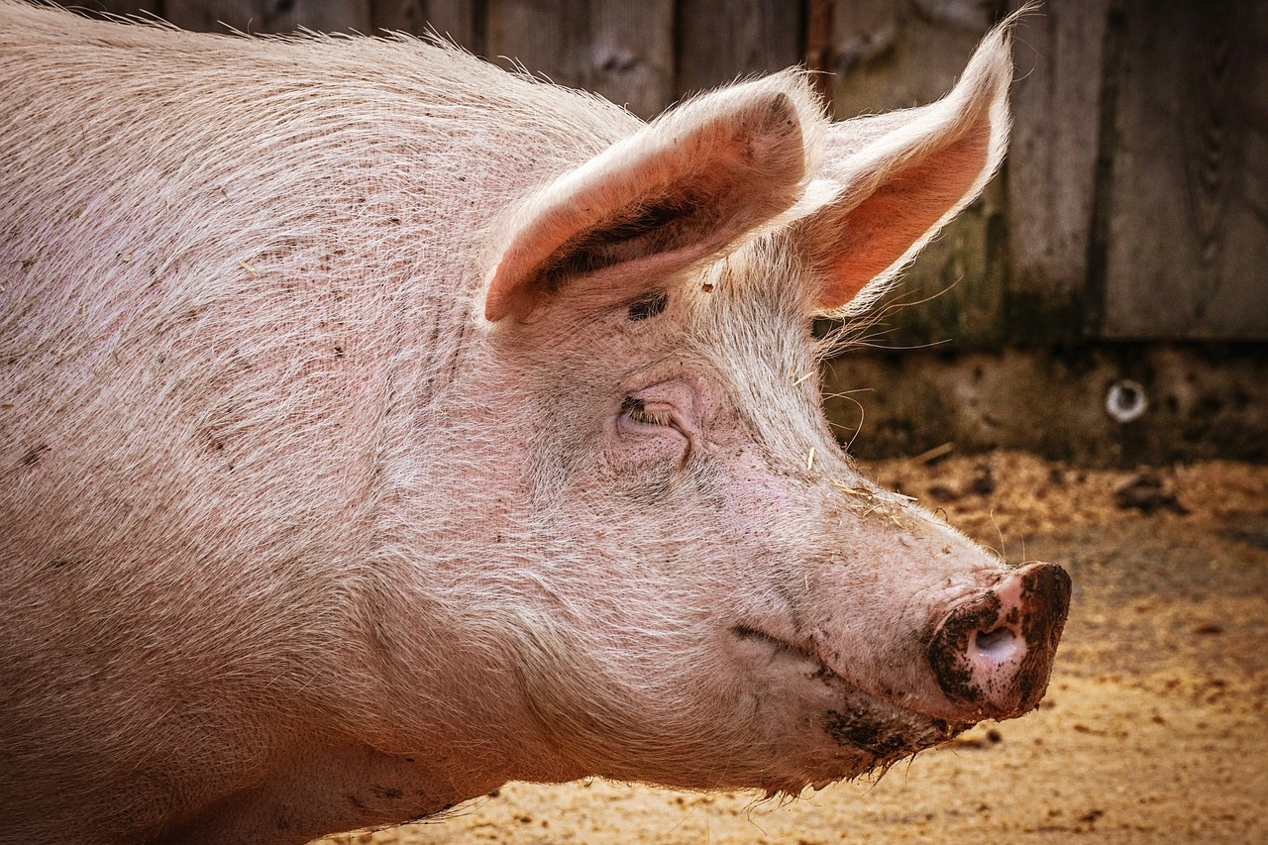
www.hologen-network.eu
Choosing the right animal for the right reason
pixabay

Slide 18
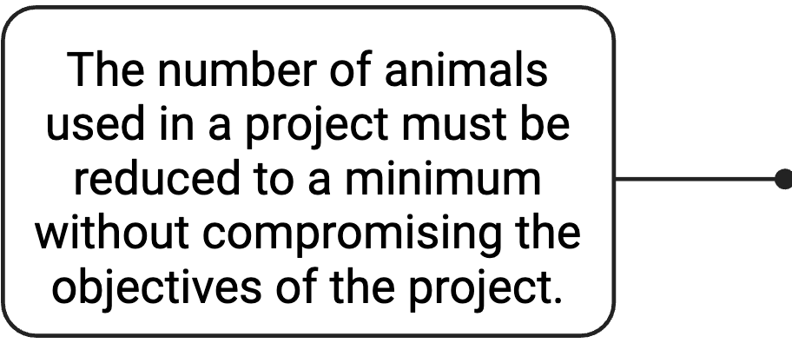
www.hologen-network.eu
3Rs principles
REDUCE
REFINE
REPLACE
biorender

Slide 19
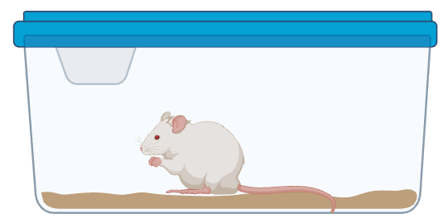
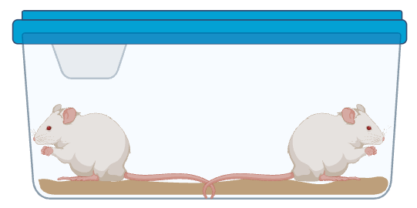
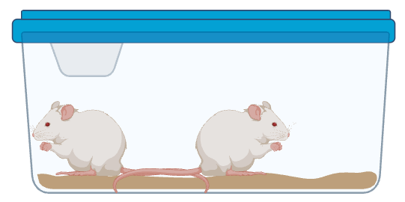
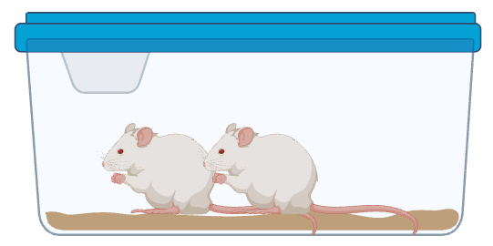
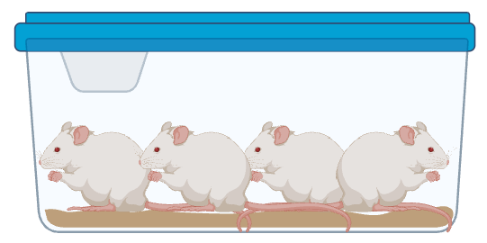
www.hologen-network.eu
Reduce
biorender

Slide 20
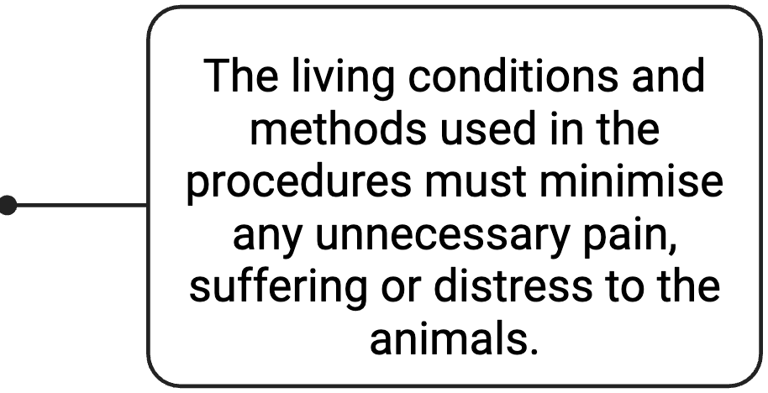
www.hologen-network.eu
3Rs principles
REDUCE
REFINE
REPLACE
biorender

Slide 21
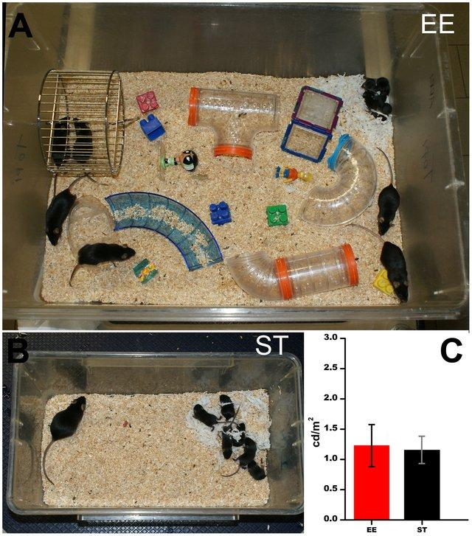
www.hologen-network.eu
Refine
Barone et al. 2012

Slide 22
www.hologen-network.eu
License to Use Animals:
Researchers must be specially trained and certified to handle animals
Institutions must be authorised by local authorities to carry out animal experiments.
Animal experimentation facility approval
Issues with wild animals

Slide 23
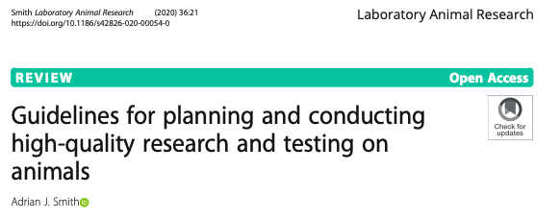


www.hologen-network.eu
https://norecopa.no/prepare/
https://www.hhs.gov/sites/default/files/ohrp-international-compilation-human-research-standards-2024.pdf

Slide 24
www.hologen-network.eu
Other permits:
Access and Benefit Sharing (ABS) & Nagoya protocol:
International sample transfers may need to adhere to national and international regulations
Animal capture
Endangered species: CITES
Protected areas
Genetically modified animals, animals with pathogens
Export and import permits
Animal by products
TRACES

Slide 25
www.hologen-network.eu
Ethics approval and the permits ready before the experiment starts

